Slide 1
Network Layer:
Internet Protocol, Version 6 (IPv6)
Lecture 14 | CSE421 – Computer Networks
Department of Computer Science and Engineering
School of Data & Science

Slide 2
IPv6
Initial motivation:
  32-bit address space soon to be completely allocated.
Additional motivation:
  Simpler header format helps speed processing/forwarding
  header changes to facilitate QoS

Slide 3
Reasons for using IPv6
Address Availability:
  IPv4: 4 octets - 32 bits
    2^32 or 4,294,467,295 IP Addresses.
  IPv6: 16 octets - 128 bits
    3.4 x 10^38 or
  340,282,366,920,938,463,463,374,607,431,768,211,456
  (340 undecillion) IP Addresses.
  Every atom of every person on Earth could be assigned 7 unique addresses with some to spare (assuming
  7 × 10²⁷ atoms per human x 6.5 Billion).

Slide 4
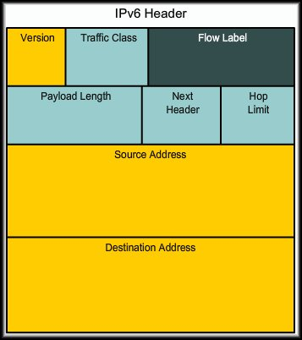
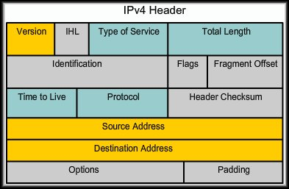
Reasons for Using IPv6
IPv6 Features:
  fixed-length 40 byte header
  no fragmentation allowed

Slide 5
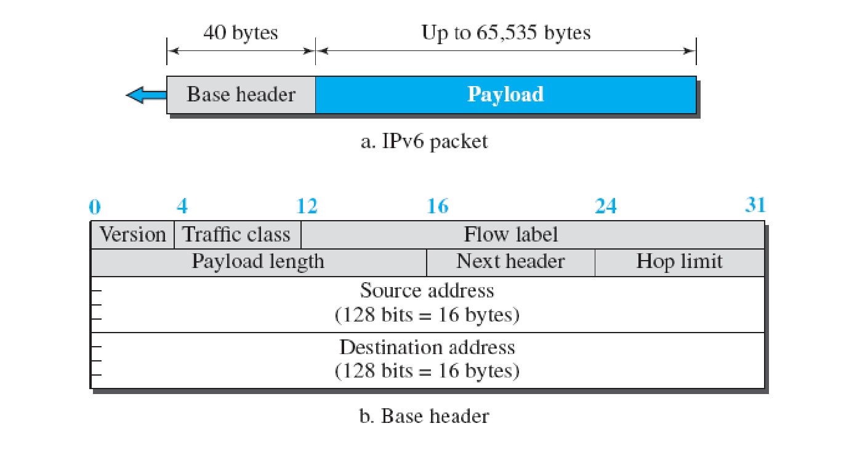
IPv6 Datagram
40 Octets, 8 fields

Slide 6
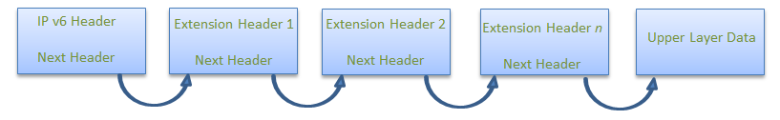
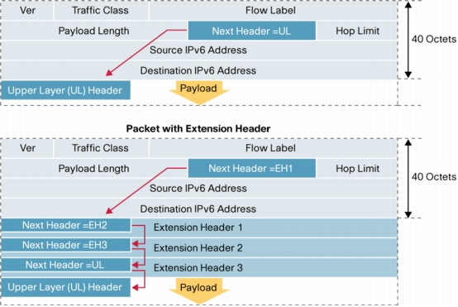
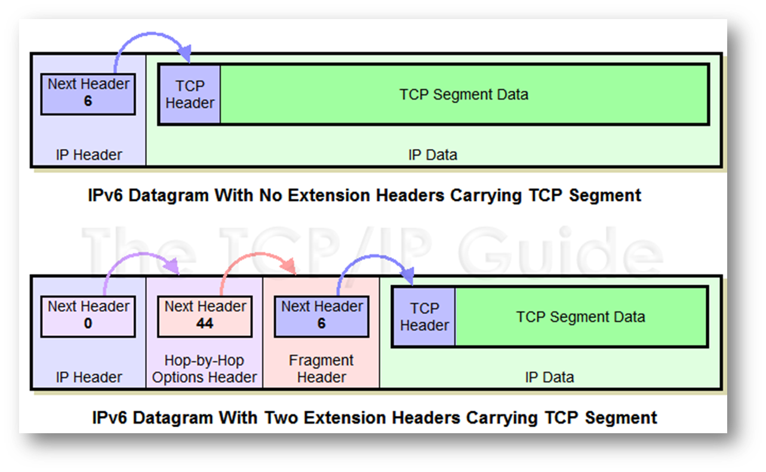
Extension Headers

Slide 7
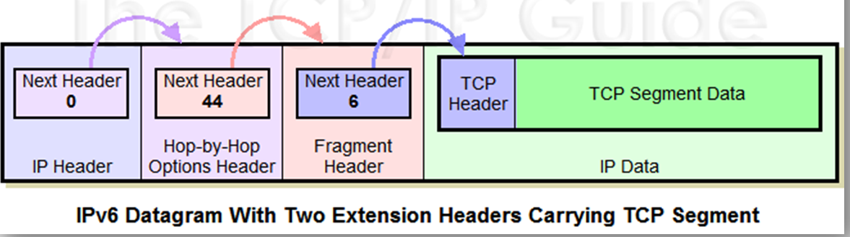
Extension Headers
Basic header simplified for ease of processing
Additional information carried in extension headers
  Hop-by-hop options (0)
  Routing header (43)
  Fragment header (44)
  Destination options header (60)
  Authentication header (AH)‏ (51)
  Encrypted security payload (ESP) header (50)
Next Header field says what type of header follows
  E.g. Fragment Header, TCP, ICMP, etc.

Slide 8
The IPv4 Header
0
4
8
16
24
31
Ver
IHL
Service Type
Total Length
Identifier
Flags
Fragment Offset
Time to Live
Protocol
Header Checksum
32 bit Source Address
32 bit Destination Address
Options and Padding
shaded fields are absent from IPv6 header

Slide 9
Header Changes between IPv4 and IPv6
Revised
  Time to Live (Hop Limit)
  Addresses increased from 32 bits to 128 bits
  Protocol (Next Header)
  Precedence & TOS (Traffic Class)
Extended
  Flow Label field added (Recommended read: Page 676 of Forouzan’s Book)

Slide 10


IPv6 Address
128 bits
given below is a 128 bit IPv6 address represented in binary format and divided into eight 16-bits blocks
Each block is then converted into Hexadecimal and separated by ‘:’ symbol
Called string notation

Slide 11
Types of IPv6 addresses
unicast
  communicate specified 1 computer
multicast
  communicate group of computers
anycast
  send group address that can receive multiple computers, but receive 1 computer
g
a
s
d
s
s
g
a
g
a
20
unicast
multicast
anycast

Slide 12
Types of IPv6 addresses
Unlike IPv4, there is no broadcast address.
There is an “all nodes multicast” which serves the same purpose.

Slide 13
Unicast Global Addresses
These are assigned by the IANA and used on public networks.
They are equivalent to IPv4 global (sometimes called public) addresses.
Typically they start at 2000::/3

Slide 14
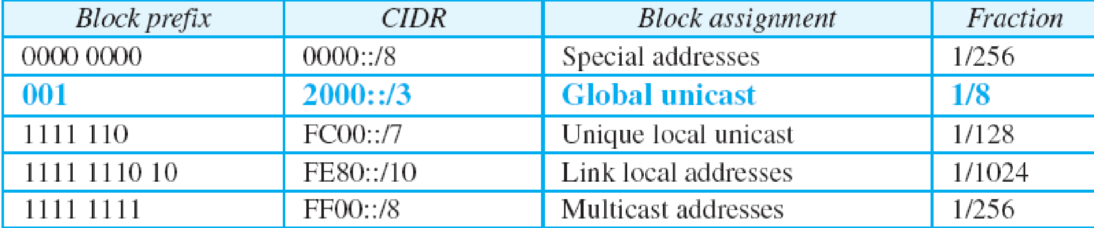
Unicast addresses
  A unicast address is an address that identifies a single device.
Types of Unicast Addresses:

Slide 15

Unicast Global Addresses
The host portion of the address is called the Interface ID.
  Can contain:
    The interface’s 48-bit MAC Address.
    An identifier derived from the EUI-64 Address
    (more later).
    A manually configured address.
24

Slide 16
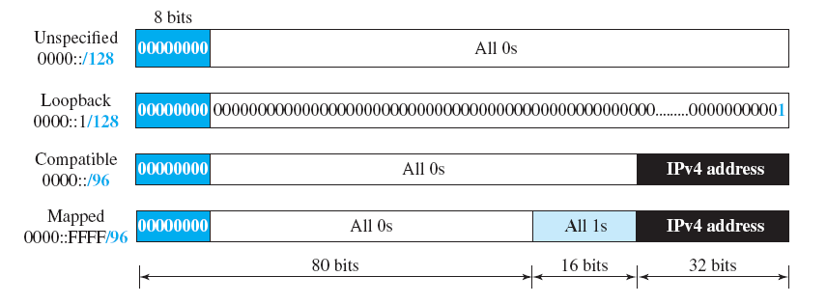
Special Addresses
Unspecified Address:
  ::/128
  In a host, it refers to the host itself, and is used when a device does not know its own address
  For addressing purposes within a software. .
Loopback Address
  ::1/128
  loopback (same as 127.0.0.1 in many IPv4 implementations)
  In IPv6 there is just one address, not a whole block, for this function.

Slide 17
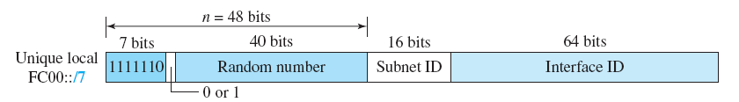
Unique Local Unicast Address
FC00::/7
Globally unique,
But it should be used in local communication.
Global ID

Slide 18
Link Local Unicast Address
FE80::/10
  These addresses refer only to a particular physical network.
  Routers do not forward datagrams using link-local addresses.
  They are only for local communication on a particular physical network segment.
      Automatic address configuration.
      Neighbor discovery.
      Router discovery. etc

Slide 19
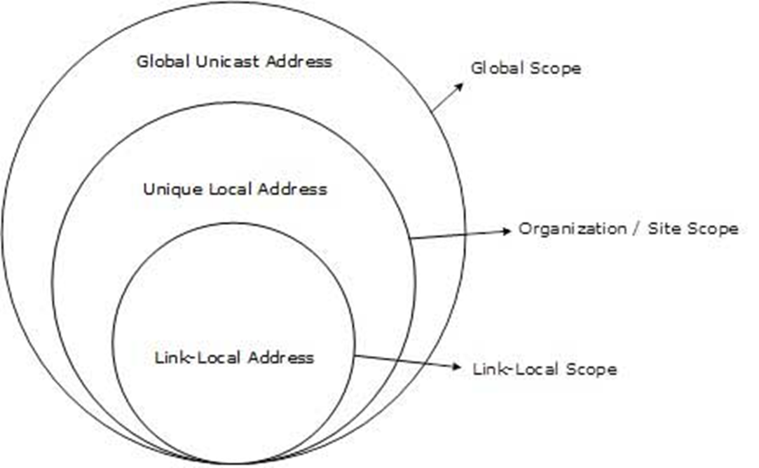
Scope of IPv6 Unicast Addresses

Slide 20
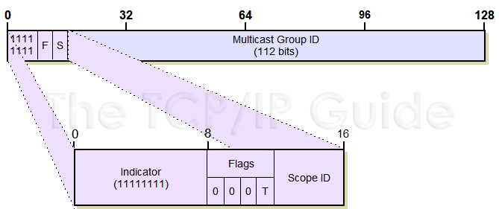
Multicast Addresses
Consisting of all addresses that begin with “1111 1111” i.e “FF”
33

Slide 21
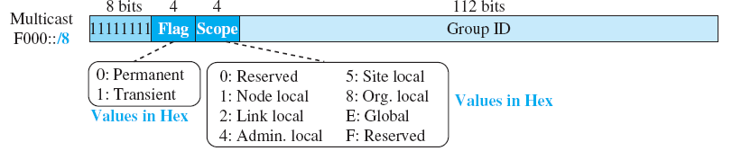
Multicast Addresses
Multicast addresses are used to send data to a number of devices on an internetwork simultaneously.
Each multicast address can be specified for a variety of different scopes
  allowing a transmission to be targeted to either a wide or narrow audience of recipient devices.
34
ff02::1 — All Nodes on the local link.ff02::2 — All Routers on the local link.

Slide 22
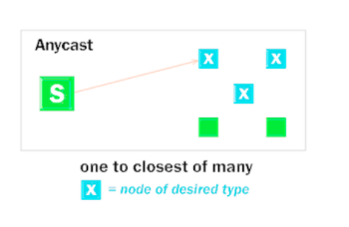
Anycast Addresses
To provide flexibility in situations where we need a service that is provided by a number of different servers or routers but don't really care which one provides it.
In routing, anycast allows datagrams to be sent to whichever router in a group of equivalent routers is closest
36

Slide 23
Anycast Addresses
There is no special anycast addressing scheme: anycast addresses are the same as unicast addresses.
An anycast address is created “automatically” when a unicast address is assigned to more than one interface.
37

Slide 24
Transition from IPv4 to IPv6

Slide 25
IPv4 to IPv6 Transition
Strategies and mechanisms:
IPv4 to IPv6 transition is gradual
IPv6 devices need to communicate to IPv4
IPv6 needs to communicate over IPv4 links
58
Notes:
IETF Transition mechanisms come under V6ops charter (was NGTrans working group until feb03)‏
http://www.ietf.org/html.charters/v6ops-charter.html
This should be a big topic, but I keep shortening it:
Summary is:
IPv6 traffic generally has to traverse IPv4 world or talk to IPv4 devices.
options:
Encapsulate it in IPv4 packets and route between two known end points.
Use tunnels such as 6to4 or Teredo for endpoints OR use compatible addresses OR mapped addresses
RFC1933 Transition Mechanisms for IPv6 Hosts and Routers
Rfc2766 NAT-pt Network Address Translation - Protocol Translation (NAT-PT)‏
NOTE: [should make this a slide]:
Dual stack node (host and router) does not mean having both IPv4 and IPv6 applications.
DNS name resolution doesn’t specify (IPv4/v6) version of peer application!
Dns lookup of ip6streamer.example.org may return IPv4 OR IPv6 OR BOTH v4&v6 addresses.
Can have various versions of an application. [e.g.: ssh tries IPv6 first and then if that times out drops back to IPv4).

Slide 26
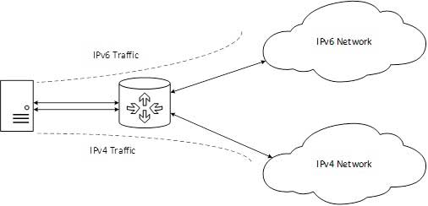
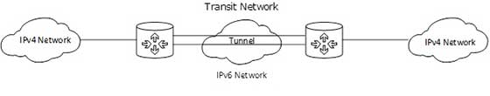
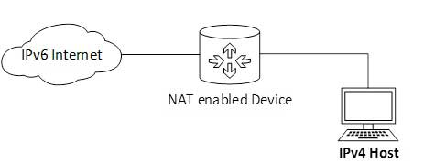
Transition Techniques
Three categories:
Dual-stack techniques
Tunneling Techniques
Translation techniques
59

Slide 27
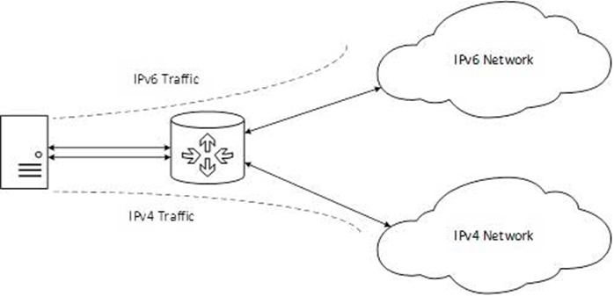
Dual Stack
Method in which a node has implementation and connectivity to both an IPv4 and IPv6 network.
The recommended option.
Involves running IPv4 and IPv6 at the same time.
60

Slide 28
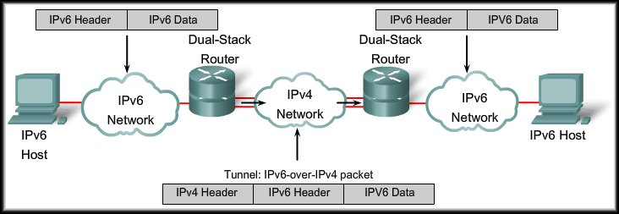
IPv6 Tunneling
Tunneling is an integration method where an IPv6 packet is encapsulated within another protocol.
Tunneling encapsulates the IPv6 packet in the IPv4 packet.
63

Slide 29
IPv6 Tunneling
When IPv4 is used to encapsulate the IPv6 packet:
  Protocol type of 41.
  20-byte IPv4 header with no options.
  IPv6 header and payload.
  Requires dual stacked routers.
64

Slide 30
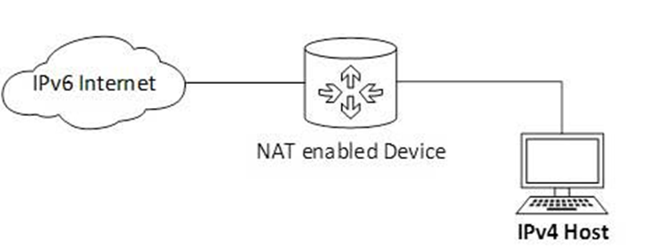
NAT Protocol Translation
Important method of transition to IPv6 by means of a NAT-PT (Network Address Translation – Protocol Translation) enabled device.
When the IPv4 host sends a request packet to the IPv6 server, the NAT-PT device/router strips down the IPv4 packet, removes IPv4 header, and adds IPv6 header and passes it through the Internet. When a response from the IPv6 server comes for the IPv4 host, the router does vice versa.
65

Slide 31
THE END

